Slide 1
MICRO PROJECT
STUDY ON THE ICE RINKS
Subject: RAC (22660)
Under the guidance of:
PROFESSOR SYED MASOOD AHMED
Prepared by:
Kazi Zaid Javed ( 17126 )
Khan Abdul Rehman Ab. Salam (17127)
Khan Saad Sameer ( 17128 )

Slide 2


Slide 3
Ice Rinks
1. Introduction
2. Types :
a. Natural Ice
b. Artificial Ice
c. Synthetic Ice
3. Working
4. Standard Rink Sizes:
a. Bandy c. Ice Hockey
b. Figure Skating d. Speed Skating

Slide 4
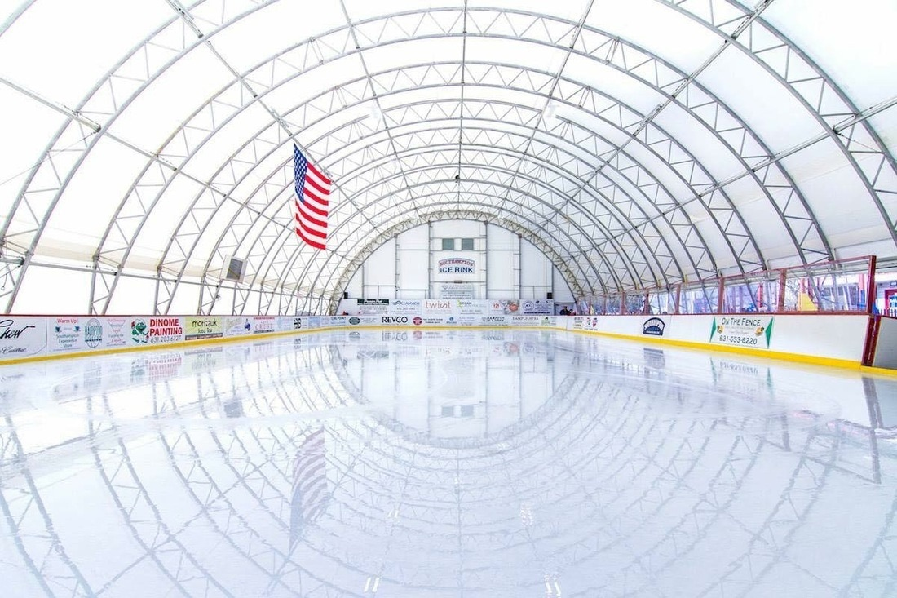
Introduction
An ice rink (or ice skating rink) is a frozen body of water and/or hardened chemicals where people can ice skate or play winter sports.

Slide 5

Types of Ice Rinks
Natural Ice Rink:
Many ice rinks consist of, or are found on, open bodies of water in climates where the surface would freeze thickly enough to support human weight. such as lakes, ponds, canals, and sometimes rivers; these can only be used in the winter. Such rinks are known as Natural Ice Rinks.

Slide 6
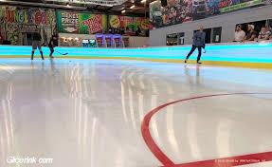
Artificial Ice Rinks:
In any climate, an arena ice surface can be installed in a properly built space. This consists of a bed of sand or occasionally a slab of concrete, through (or on top of) which pipes run. The pipes carry a chilled fluid which can lower the temperature of the slab so that water placed atop will freeze. This method is known as Artificial Ice Rink
Types of Ice Rinks

Slide 7
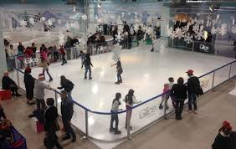
Types of Ice Rinks
Synthetic Ice Rinks:
Synthetic rinks are constructed from a solid polymer material designed for skating using normal metal-bladed ice skates A typical synthetic rink will consist of many panels of thin surface material assembled on top of a sturdy, level and smooth sub-floor to create a large skating area.

Slide 8
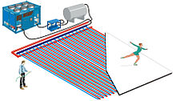
Working
In ice rinks, the refrigerant cools brine water, an anti-freezing agent, which goes through pipes underneath the ice. These steel pipes are typically embedded into a concrete slab and kept at 32 F / 0 C, so that any water placed on top of the slab freezes and becomes the skating surface that we see.

Slide 9
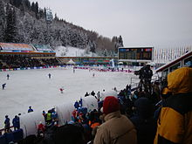
Standard Rink Sizes
Bandy:
In bandy, the rink size is 90–110 m (300–360 ft.) x 45–65 m (148–213 ft.). For internationals, the size must not be smaller than 100 metres (330 ft.) x 60 metres (200 ft.). The variety rink bandy is played on ice hockey rinks.

Slide 10
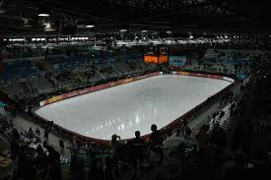
Figure Skating:
The size of figure skating rinks can be quite variable, but the International Skating Union prefers Olympic-sized rinks for figure skating competitions, particularly for major events. These are 60 meters by 30 meters. The ISU specifies that competition rinks must not be larger than this and not smaller than 56 meters by 26 meters.

Slide 11
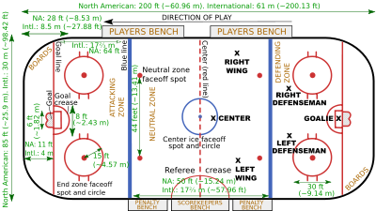
Ice Hockey:
There are basically two rink sizes in use, although there is a great deal of variation in the dimensions of actual ice rinks. Historically, earlier ice rinks were smaller than today.
Official National Hockey League rinks are 26 m × 61 m (85 ft × 200 ft). The dimensions originate from the size of the Victoria Skating Rink in Montreal, Quebec, Canada. Official Olympic/International rinks have dimensions of 30 m × 60 m (98.4 ft × 197 ft).

Slide 12
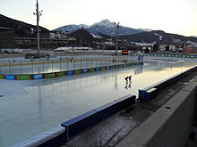
Speed Skating:
In speed skating, for short track, the official Olympic rink size is 30 x 60 meters, with an oval ice track of 111.12 meters in circumference. In long track speed skating the oval ice track is usually 400 meters in circumference.

